Slide 1
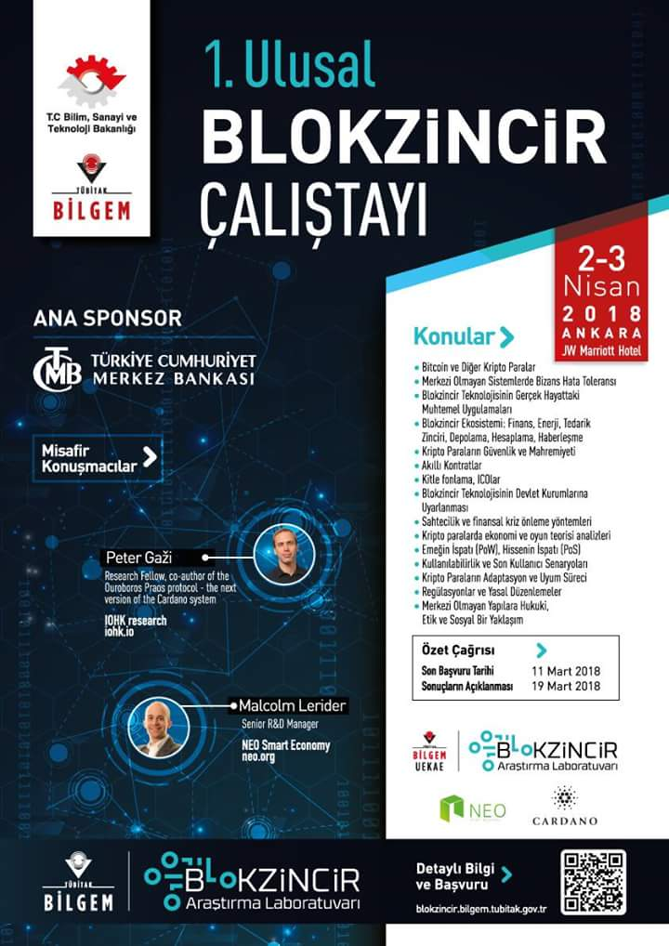
Enterprise Distributed Application Development using the NEO Blockchain
Welcome Neoxplorers!
Michael Herman
Independent Blockchain Developer
NEO C# Developers Center of Excellence
neotoronto@outlook.com

Slide 2
1. Introduction

Slide 3
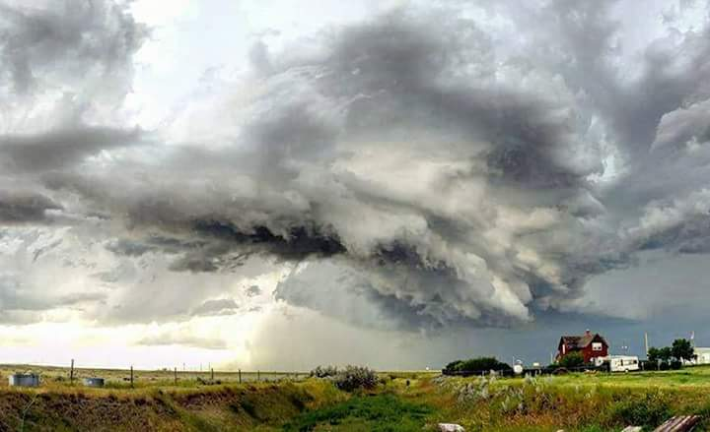

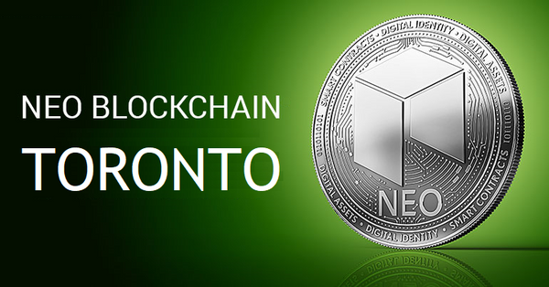
Who is Michael Herman?
Independent Blockchain Developer
I work 14 hours a day on the NEO Blockchain
Experienced Ethereum Developer
I work for myself (and on behalf of my clients)
Decades of software development experience
Developer on very version of Microsoft Windows since the very first
Microsoft, IBM, medium-size companies, small businesses
Curator of NEO C# Developers Center of Excellence community (neo-csharp)
Contributes to several NEO community projects
NEO developer tool suite: neo-debugger and neo-gui-developer projects
NEO Persistable Class Framework (NPC) for efficient object-oriented smart contract development using C#.NEO: mwherman2000/neo-persistibleclasses and neo-npcc2s
NEO Blockchain Quick Start Guide for .NET Developers: mwherman2000/dotnetquickstart
Founder of the first Canadian NEO Blockchain Meetup: NEO Blockchain Toronto

Slide 4
Who are you?
Software Developer/Achitect?
NEO smart contract developers?
Ethereum smart contract developers?
Other blockchain developers?
Microsoft .NET developers? .NET/C#/Visual Studio
Crytopinvestor/trader?
Legal profession?
Financial services (conventional)?
Government?
Banking?
Other sectors?
Students?

Slide 5


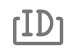
What is the NEO Smart Economy?
Digital Assets
+
NEO
Smart Economy
Smart Contracts
+
Digital Identity
“Future world where the boundary between real assets in the physical world and digital assets in the digital world has been removed.” [Malcolm Lerider, March 2018]

Slide 6
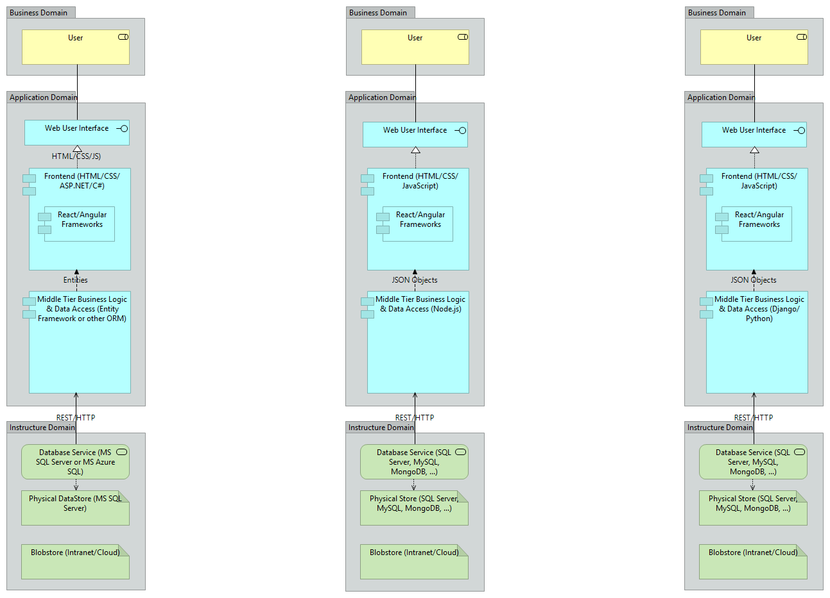
Traditional Multi-Tier Enterprise Applications
Microsoft ASP.NET/EF/SQL
Full Stack HTML/CSS/Node.js
Full Stack HTML/CSS/Python

Slide 7
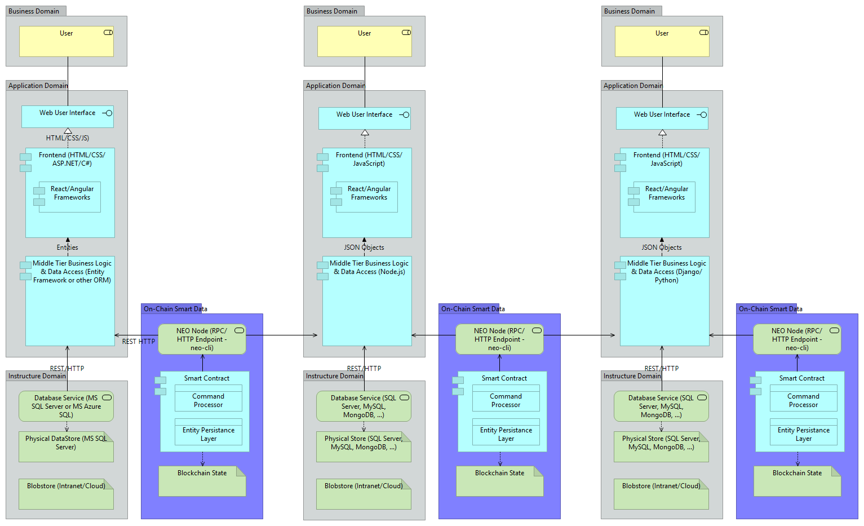
Enterprise Distributed Application Architectures
Microsoft ASP.NET/EF/SQL
Full Stack HTML/CSS/Node.js
Full Stack HTML/CSS/Python
Smart Data =
Smart Contract
+ Non-fungible Entities
C#
Java
Python

Slide 8
When to use Blockchain Technology “Blockchain: the force multiplier for the smart economy” [Microsoft]
Questions to Ask
Use a Blockchain when there is a Need for
Is it a business process that crosses trust boundaries?
Do multiple parties manipulate the same data?
Are processes operating inefficiently or decisions delayed due to the number of intermediaries?
Does the business process involve low-value, manual verification steps?
Real-time transparency by connecting business processes across organizations
Real-time, transparent access to a verifiable source of the truth across organization boundaries
Introduce trust and increase efficiency amongst participants - reducing the need for intermediaries
Improved efficiencies and increased confidence through automation and smart contracts that execute consistently.
“Use blockchain technology when it matches the requirements of your application. Don’t automatically use blockchain technology simply because you’re re-platforming an existing application.” [Gartner 2018]

Slide 9
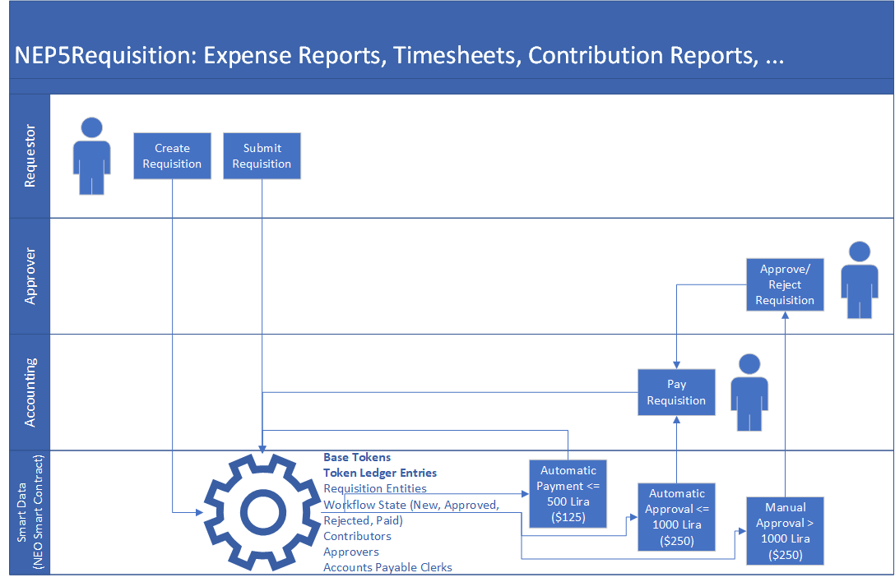
Think Deeply about the NEO Smart Economy “Future world where the boundary between real assets in the physical world and digital assets in the digital world has been removed.”
transfer
ATrzHaicmhRj15C3Vv6e6gLfLqhSD2PtTr
AK2nJJpJr6o664CWJKi1QRXjqeic2zRp8y
AZ9Bmz6qmboZ4ry1z8p2KF3ftyA2ckJAy
AZ9Bmz6qmboZ4ry1z8p2KF3ftyA2ckJAy
NEP5 / ERC20
Tokens
ATrzHaicmhRj15C3Vv6e6gLfLqhSD2PtTr
requisitions
AK2nJJpJr6o664CWJKi1QRXjqeic2zRp8y
transfer
transfer
payments
requisitions

Slide 10
NEP5Requisition Processing
Expense Reports
Timesheets
Contribution Reports
Lottery Tickets
Loyalty Points
Discount Coupons
Vouchers
Stock Certificates
Disbursements
requisitions
payments
requisitions

Slide 11
Think Deeply about the NEO Smart Economy “Future world where the boundary between real assets in the physical world and digital assets in the digital world has been removed.” [Malcolm Lerider]
1. create & submit
transfer
ATrzHaicmhRj15C3Vv6e6gLfLqhSD2PtTr
AK2nJJpJr6o664CWJKi1QRXjqeic2zRp8y
AZ9Bmz6qmboZ4ry1z8p2KF3ftyA2ckJAy
ATrzHaicmhRj15C3Vv6e6gLfLqhSD2PtTr
AK2nJJpJr6o664CWJKi1QRXjqeic2zRp8y
AZ9Bmz6qmboZ4ry1z8p2KF3ftyA2ckJAy
AZ9Bmz6qmboZ4ry1z8p2KF3ftyA2ckJAy
NEP5 / ERC20
Tokens
ATrzHaicmhRj15C3Vv6e6gLfLqhSD2PtTr
NEP5Requisition
Proposal
1. create & submit
AK2nJJpJr6o664CWJKi1QRXjqeic2zRp8y
3. pay
2. approve/reject/reroute
transfer
transfer
3. pay
2. approve/reject/reroute
Smart
Data

Slide 12
Smart Data = Smart Contract + Non-Fungible Entities
create
Smart Contract
query
NEP5TokenBase
NEP5LedgerEntry
Requisition
Contributor
Approver Role
Accounts Payable Role
Public/Public App Keys
Workflow State
User Credentials
Counters
submit
get
Non-Fungible Data Entities
Smart
Data
approve
register
reject
pay
reroute

Slide 13
Purpose and Goals
Purpose
Hands-on smart contract development workshop: .NET/C#/Visual Studio on the NEO Blockchain
Goals, Non-goals and Assumptions
Target audience: Architects and Developers who are new to the NEO Blockchain platform
Background: Very little or no previous NEO or .NET/C#/Visual Studio Experience
Background: Understand basic 1st and 2nd generation blockchain technologies: hashing, blocks, mining, etc.
Provide you with a basic level of awareness and understanding of NEO smart contract development
Help create a strong NEO Blockchain community in Turkey – helping each other
Principles
Provide reliable documentation: timely, accurate, visual, and complete
Save as much of a person's time as possible
Use open source software whenever possible
Drivers
Need in the NEO .NET developer community to have concise and easy-to-follow documentation to enable people to get up to speed developing NEO smart contracts in as short a time as possible

Slide 14
Agenda
Introduction
Preparation for the Hands-on Labs
Module 1 Hands-on Labs (x3)
Why NEO?
BREAK – 15 minutes
NEO Architecture
Module 2 Hands-on Labs (x3)
Why NEO?
BREAK – 15 minutes
NEO as a 3rd Generation Distributed App (dApp) Platform
Smart Contract Development using Entities
NEO Evidence
NEO Resources
Next Steps

Slide 15
2. Preparation for the Hands-on Labs

Slide 16
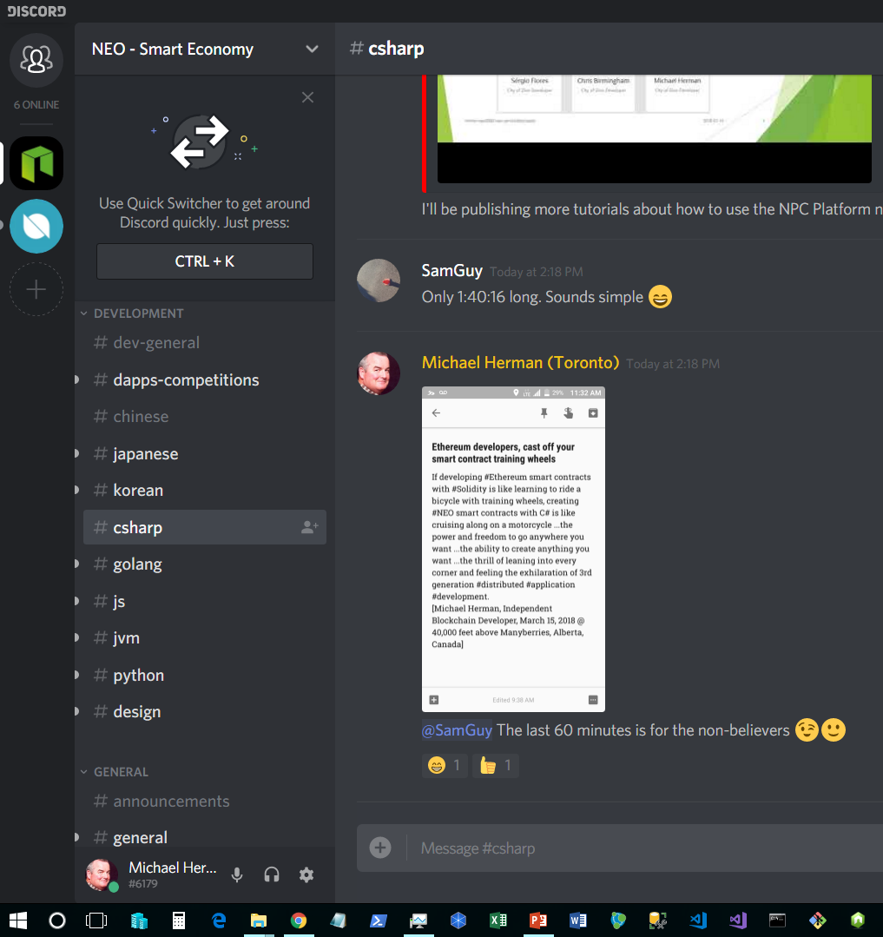
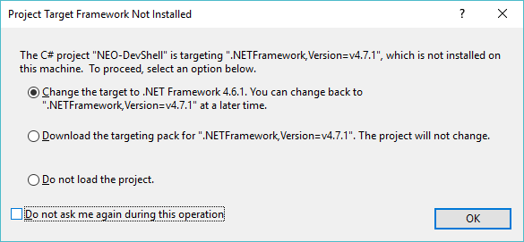
Preparation: Twitter, Discord and Visual Studio
I will be sending links to additional downloads and information using #BlockchainTURKIYE on Twitter.
Join Discord NEO Developer Community on Discord by clicking on one of the following links: https://discord.gg/gqCYeup or https://discord.gg/4TQujHj
Download and install Microsoft Visual Studio Community Edition 2017. This version is free to download and free to use. It is an excellent IDE for C# smart contract development. https://www.visualstudio.com/vs/community/
Download and install the .NET 4.7.1 Dev Pack from here: https://www.microsoft.com/en-us/download/details.aspx?id=56119
Install the NEO Smart Contact Visual Studio 2017 Extension See next slide

Slide 17
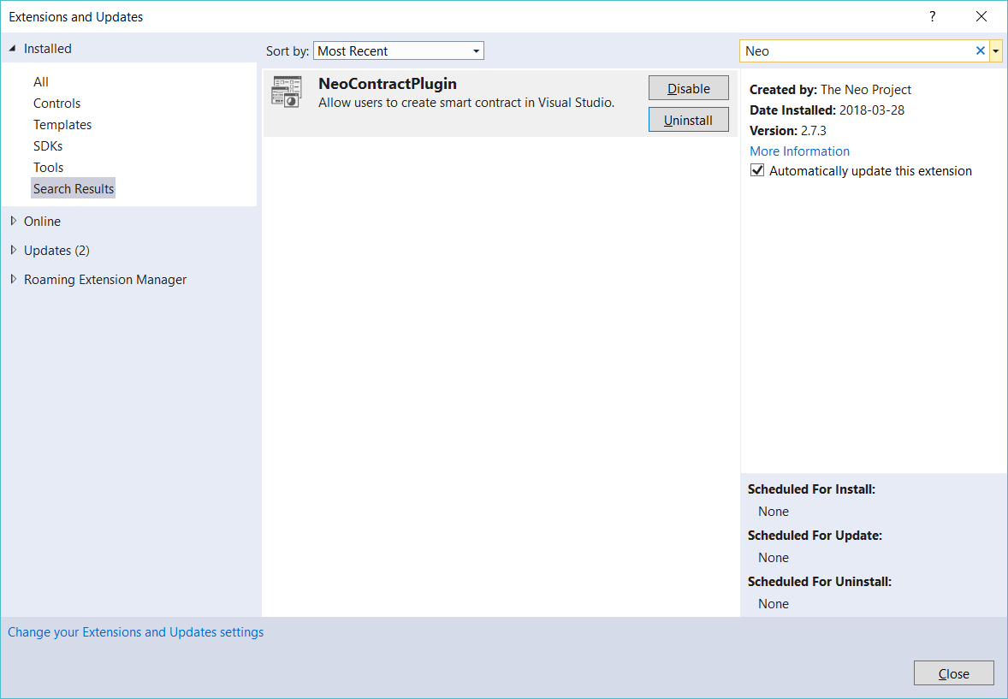
NEO Smart Contract Visual Studio Extension

Slide 18
Mac Users
How to write smart contracts in C# on macOS http://docs.neo.org/en-us/sc/getting-started-csharp-mac.html

Slide 19
Preparation: NEO Debugger Tools
Download the NEO Debugger Tools source code. https://github.com/mwherman2000/neo-debugger-tools/archive/master.zip The downloaded file will be called: neo-debugger-tools-master.zip
Create a new folder on your hard drive – for example c:\repos
Copy neo-debugger-tools-master.zip into c:\repos
Unzip neo-debugger-tools-master.zip and build the NEO Debugger Tools following the steps using diagram below.
**NOTE** Please download a new copy of the neo-debugger-tools-master.zip file. It was updated last night.
Lastly, update your Windows PATH environment variable to include the path to the NEO Compiler neon.exe by typing the following into the Windows command prompt:
setx PATH "%PATH%;C:\repos\neo-debugger-tools-master\NEO-Compiler\bin\Debug"

Slide 20
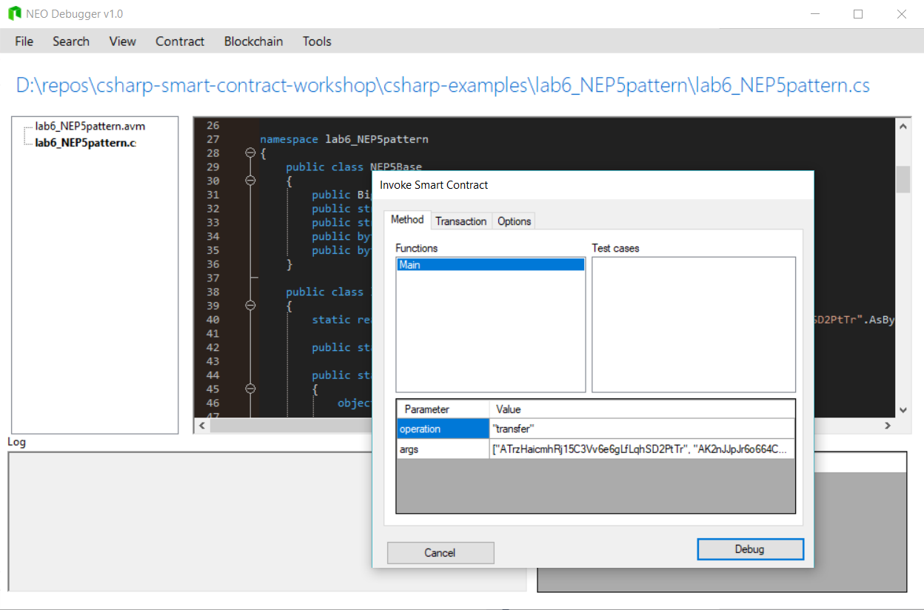
NEO Debugger
Commands
F10 – Single Step
F5 – Run
F6 – Storage Viewer

Slide 21
3. Module 1 Labs
Runtime.Log(), Runtime.Notify(), and NEO Storage

Slide 22
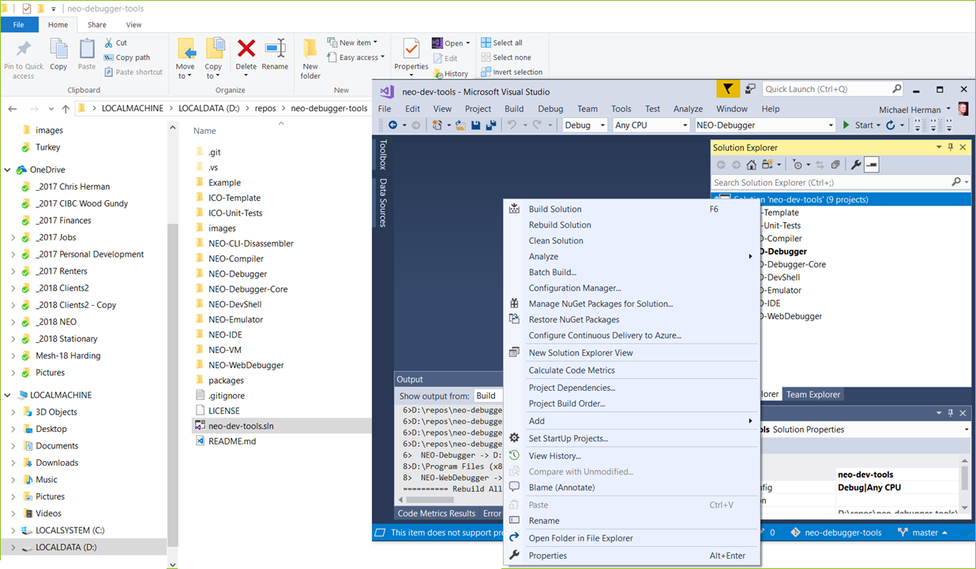
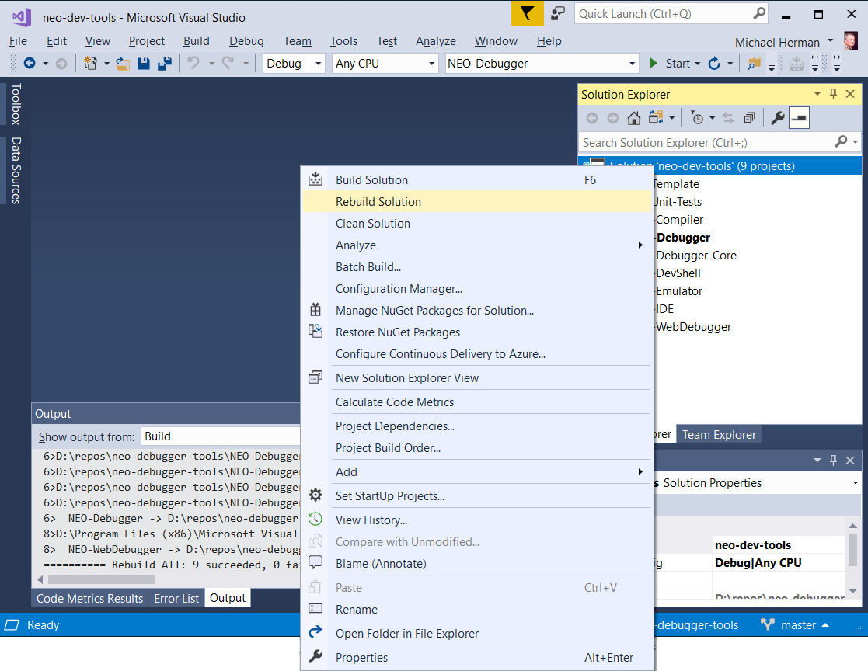
A
C
D
B
E

Slide 23
Lab 1 - lab1_log.cs
“Hello World” Hands-on Lab

Slide 24
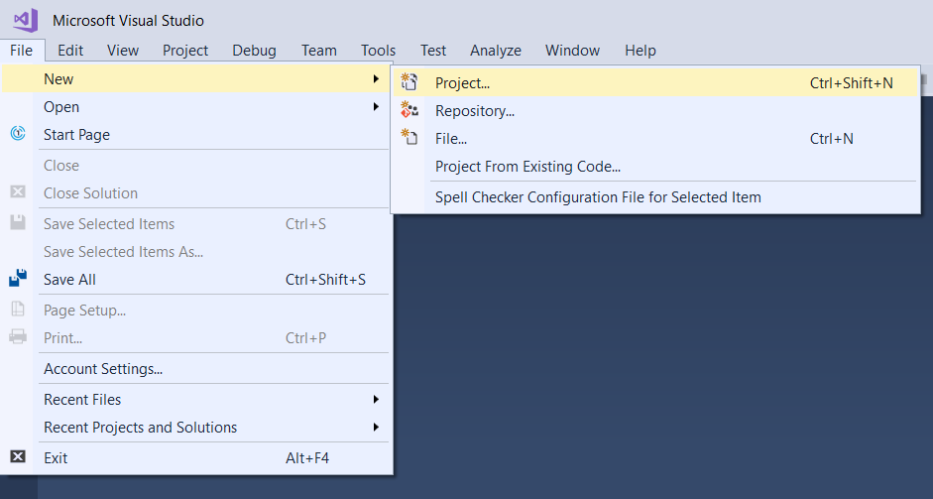

Slide 25
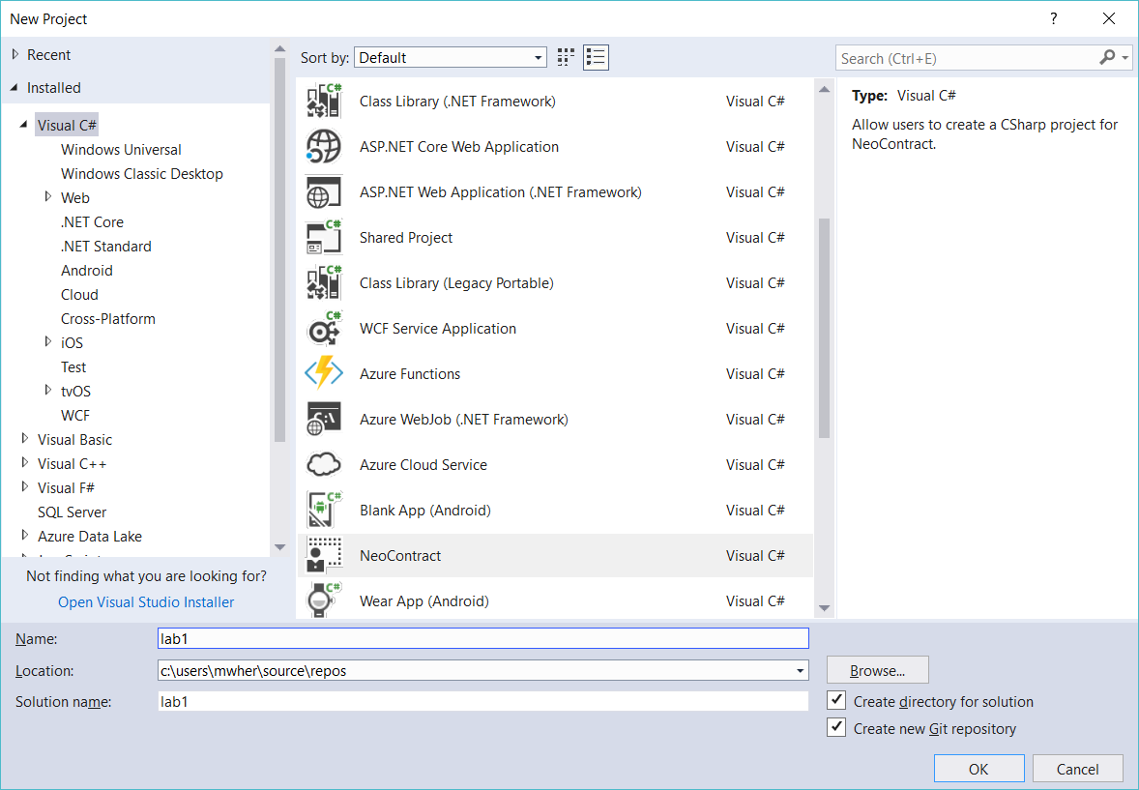

Slide 26
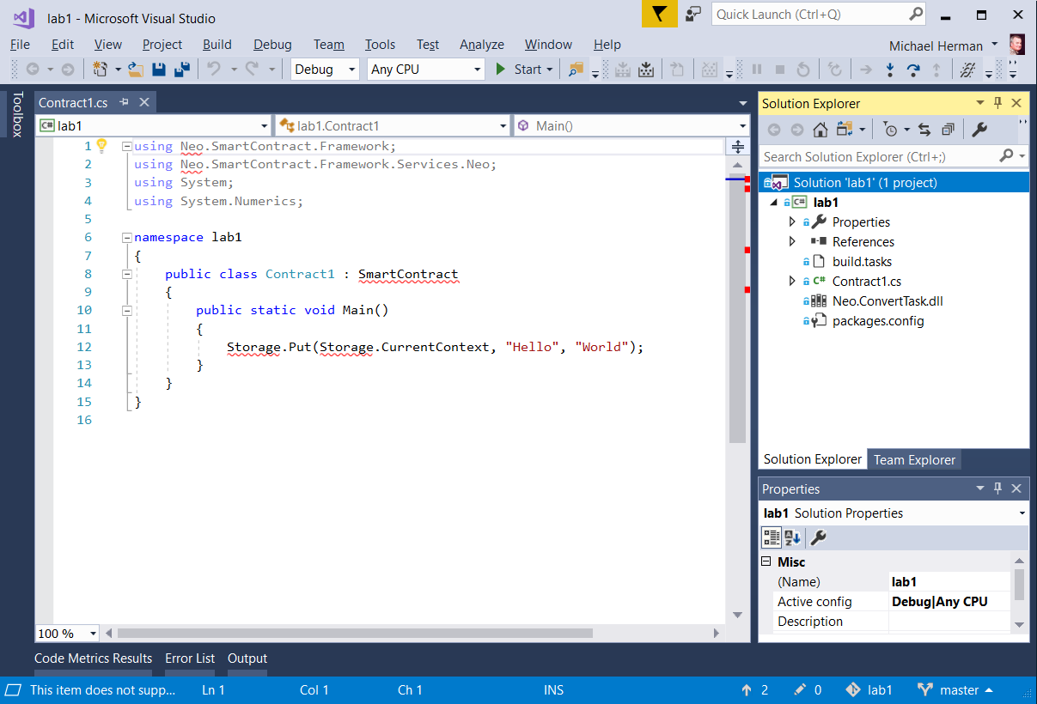
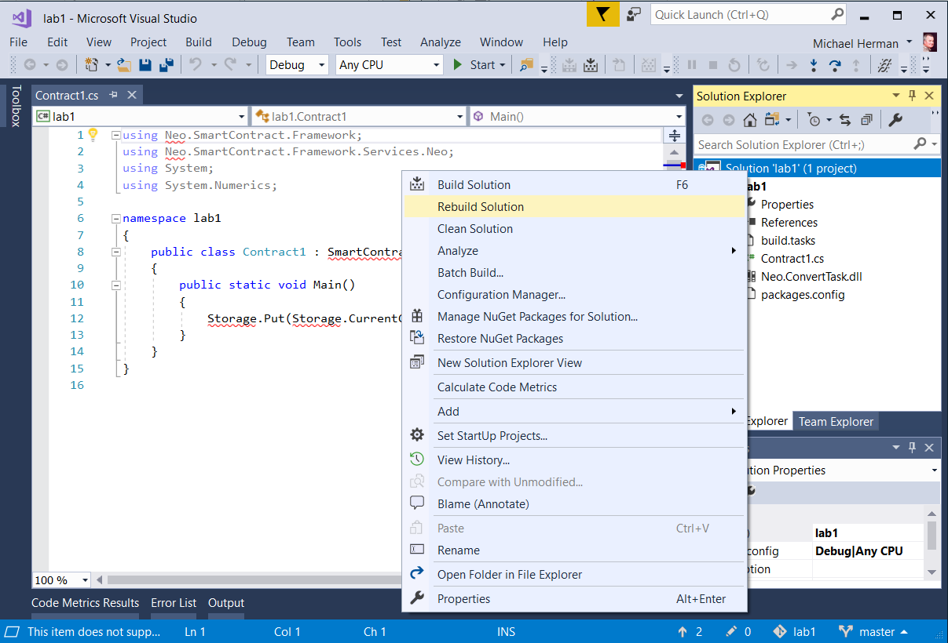

Slide 27
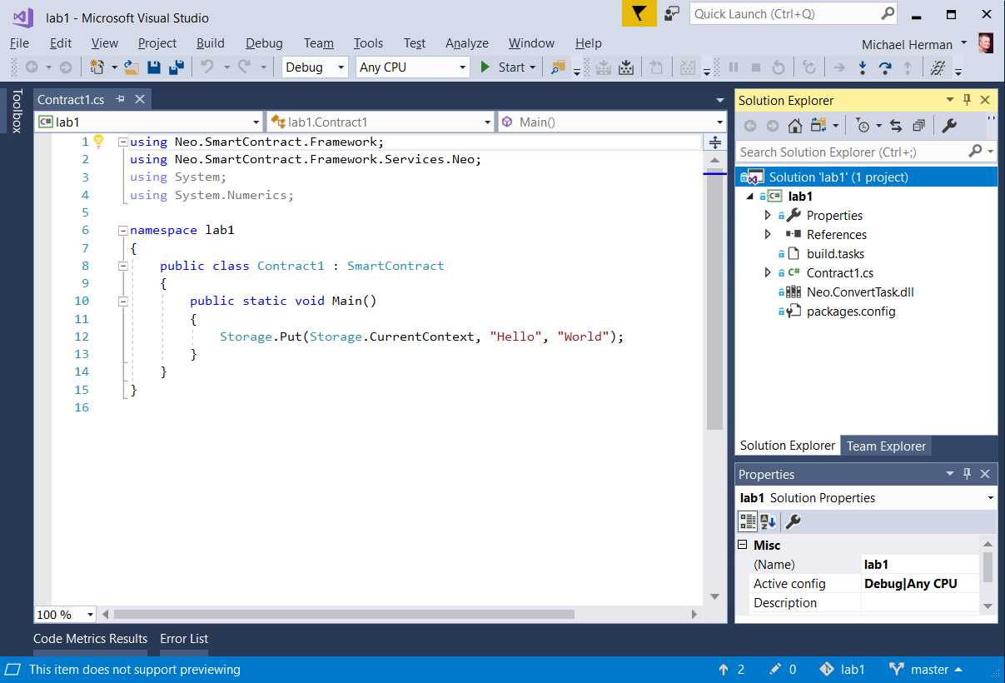

Slide 28
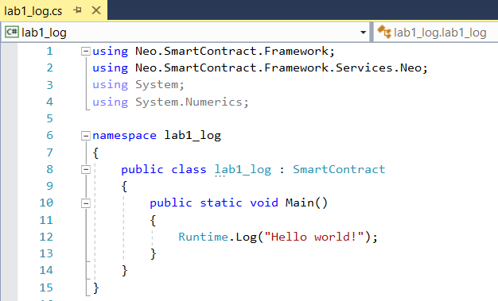

Slide 29
Lab 2 – lab2_logandnotify.cs
Runtime.Log() and Runtime.Notify()

Slide 30
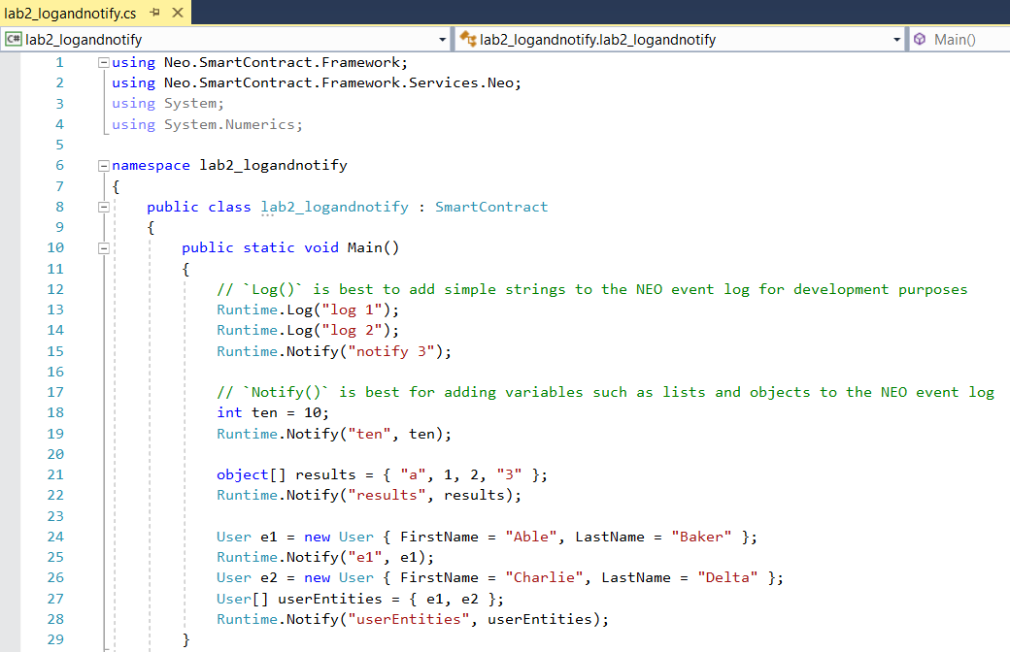

Slide 31
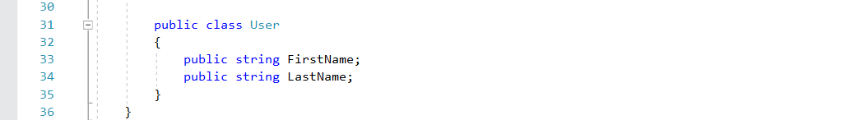

Slide 32
Lab 3 – lab3_storage.cs
NEO Storage

Slide 33
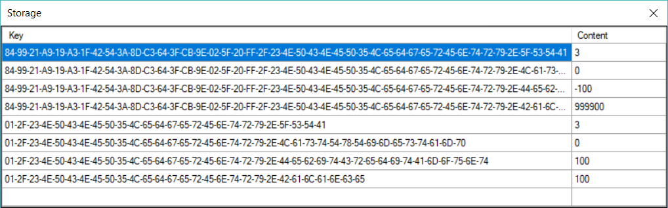
NEO Storage
Each smart contact deployed to the NEO Blockchain has it’s own key-value data store
Keys = byte[] array
Values = string, byte[] array or BigInteger

Slide 34
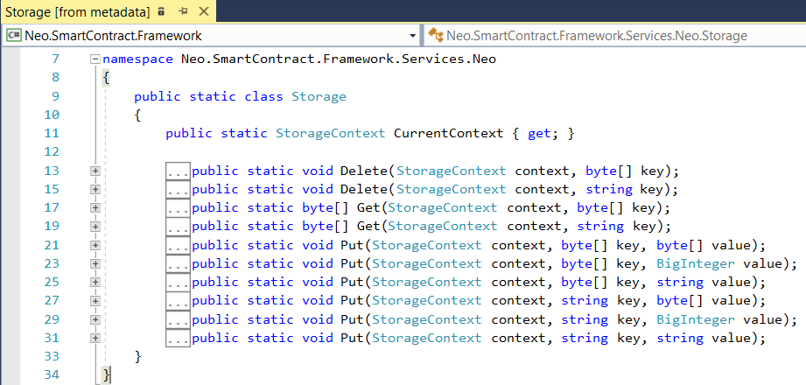
NEO Storage API

Slide 35
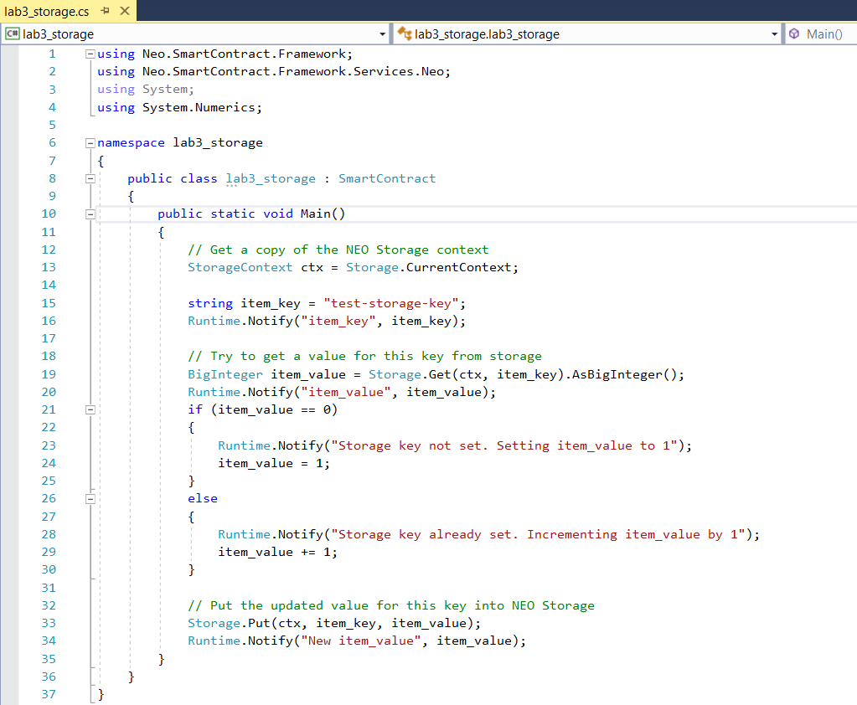

Slide 36
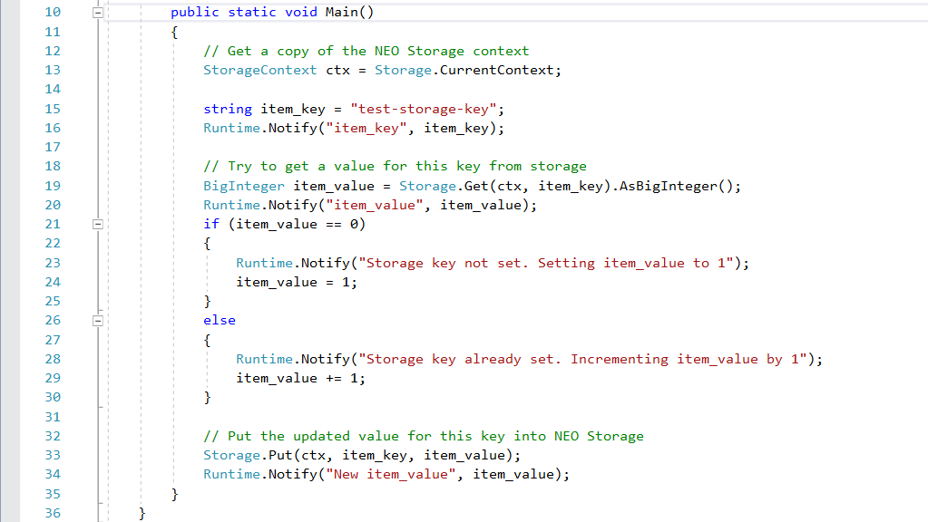

Slide 37
End of Module 1
Lab 1 - lab1_log.cs
Lab 2 – lab2_logandnotify.cs
Lab 3 – lab3_storage.cs

Slide 38
4. What is NEO?

Slide 39
What is NEO?
PROJECT: NEO (https://neo.org/) is a non-profit, community-based blockchain project that utilizes blockchain technology and digital identity to digitize assets, to automate the management of digital assets using smart contracts, and to realize a "smart economy" with a distributed network.
SOFTWARE PLATFORM: 3rd generation distributed applications (dApp) platform
Multiple languages: C# (reference implementation), Python, Java, Golang, JavaScript
First dApp platform suitable for enterprise application development, deployment, and operations
DUAL CRYPTOCURRENCY: NEO and GAS
NEO SMART ECONOMY
Key differentiator
GLOBAL COMMUNITY
Discord: https://discord.gg/gqCYeup / https://discord.gg/4TQujHj
NEO C# Developers Center of Excellence (neo-csharpcoe) https://github.com/mwherman2000/neo-csharpcoe/blob/master/README.md
NEL (NewEcoLab) “Chinese-speaking NEO Community” https://github.com/neweconolab
City of Zion “Home of the Open-source Global NEO Developer Community” https://cityofzion.io/

Slide 40
Dual Cryptocurrency Model: NEO and NeoGas
NEO Smart Economy, there is a separation of concerns:
NEO represents Voting Power
NeoGas represents Ability to Fund Work (Systems Fees)
NEO (NEO)
Intended use: acquire, hold, and retain NEO to maximize your voting power in the network
Receive distributions of GAS
NeoGas (GAS)
Sometimes referred to as a “Utility Token” or the “Fuel Token”
Used to fund the deployment of smart contracts (applications) on the NEO Blockchain
Used to fund transactions executed on the NEO Blockchain
System Fees are recycled and re-distributed in ratio/proportion to the number of NEO you hold

Slide 41
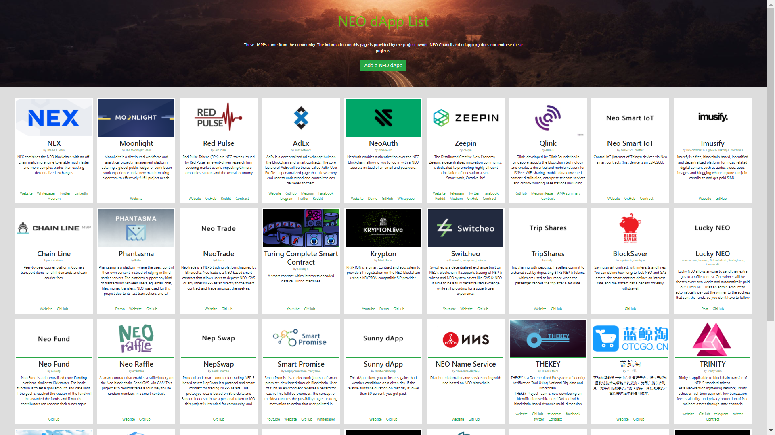
http://ndapp.org

Slide 42
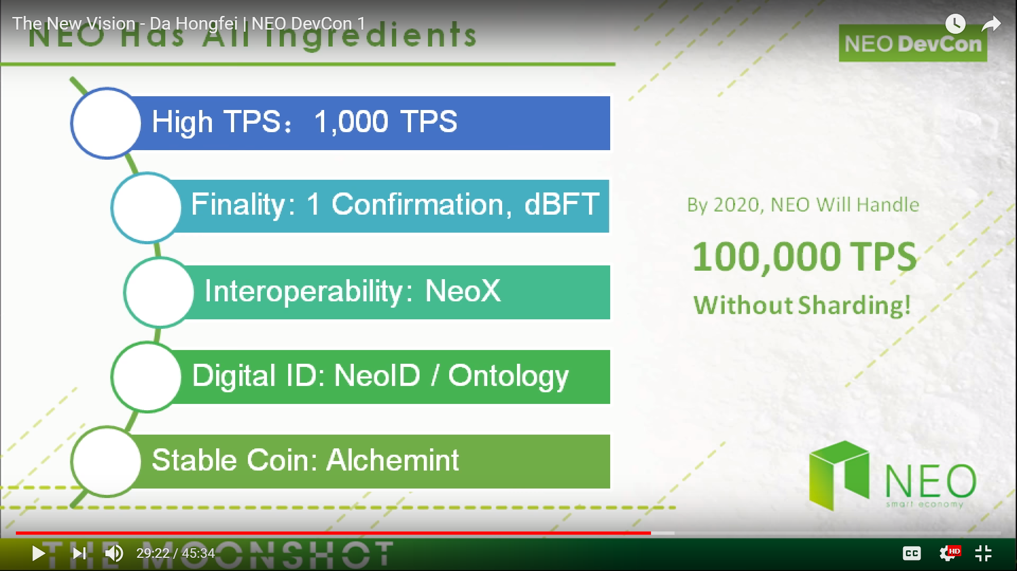
Next Killer Blockchain Platform?

Slide 43
NEO Decentralized Applications (Use Cases)
Smart fund
AI-assisted legal smart contracts
Social networking
Automated token liquidity providers
Decentralized exchanges
Secure communications protocol
Supply chain (parts, food, wine, …)
Consortiums (business partnerships)
Data exchange markets
Intellectual property trading markets
Prediction markets
Advertising markets
Hashpower (cryptohealth) markets
NeoGas markets
Business process re-engineering
Requisition processing

Slide 44
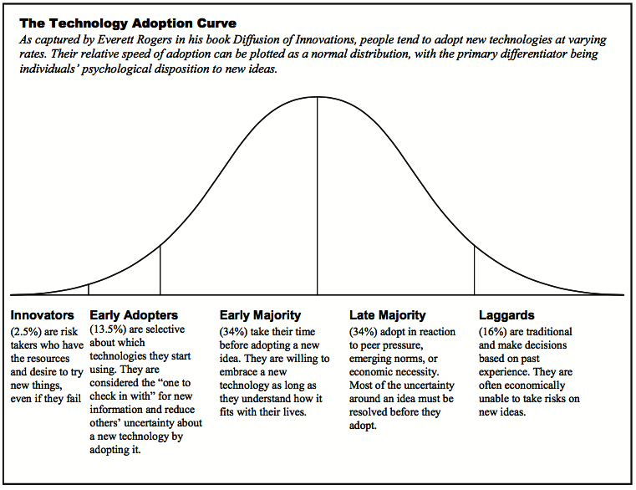
Blockchain: Early Adopters Marketplace

Slide 45
2. NEO Architecture
NEO Whitepaper

Slide 46
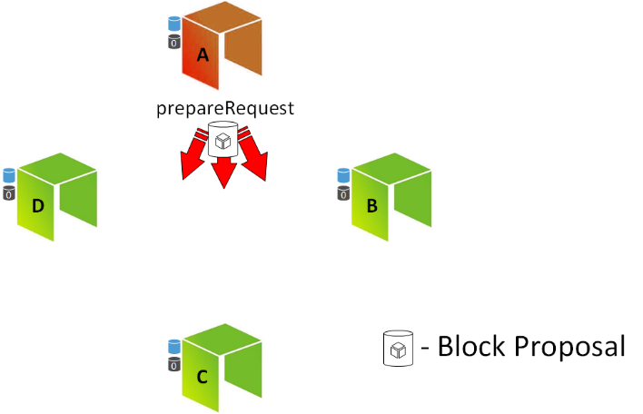
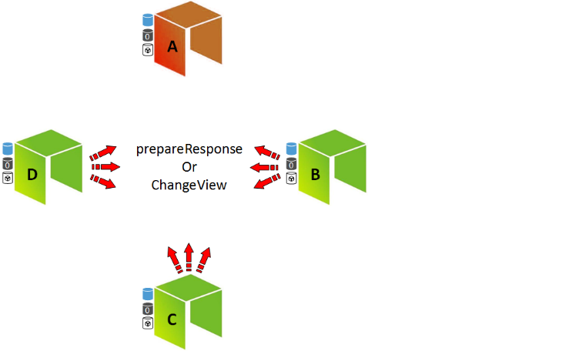
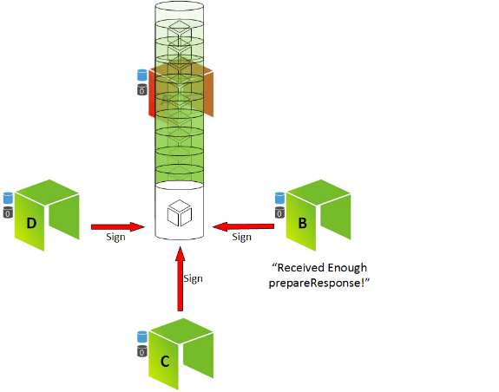
Delegated Byzantine Fault Tolerance (dBFT) NEO Consensus Mechanism
NEO: There is no competition to create the next block (e.g. no miners, no PoW)
NEO: There is no betting or staking to choose the next block (e.g. no PoS)
NEO: Consensus nodes are voted in as representatives to choose the next block
NEO: No reward for your own node to be selected

Slide 47




Problems with Proof of Work and Proof of Stake
1. Proof of Work (PoW)
2. Proof of Stake (PoS)

Slide 48
PoW and PoS compared to dBFT
Consensus algorithm: PoW and PoS
Consensus algorithm: dBFT
One and only one branch

Slide 49
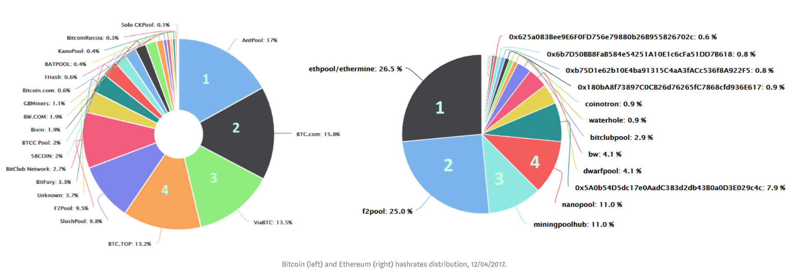
How decentralized are the BTC and ETH networks?
Coopetition: A New Approach to Decentralization https://medium.com/proof-of-working/decentralization-from-coopetition-b10d7ce3b9d

Slide 50
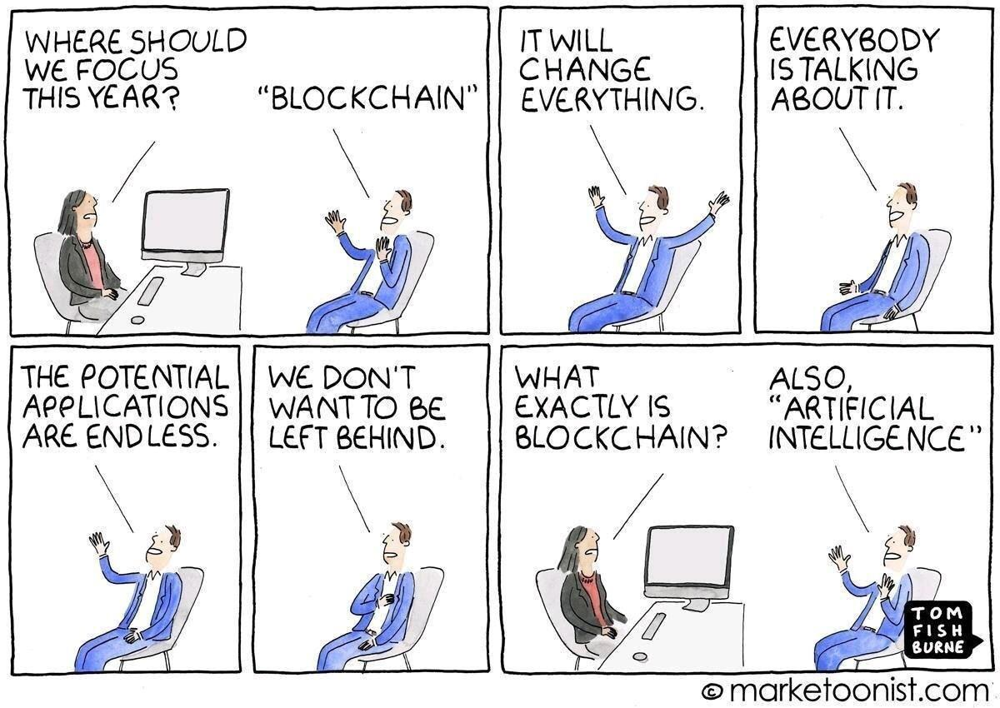
BREAK – 15 MINUTES

Slide 51
5. NEO Architecture

Slide 52
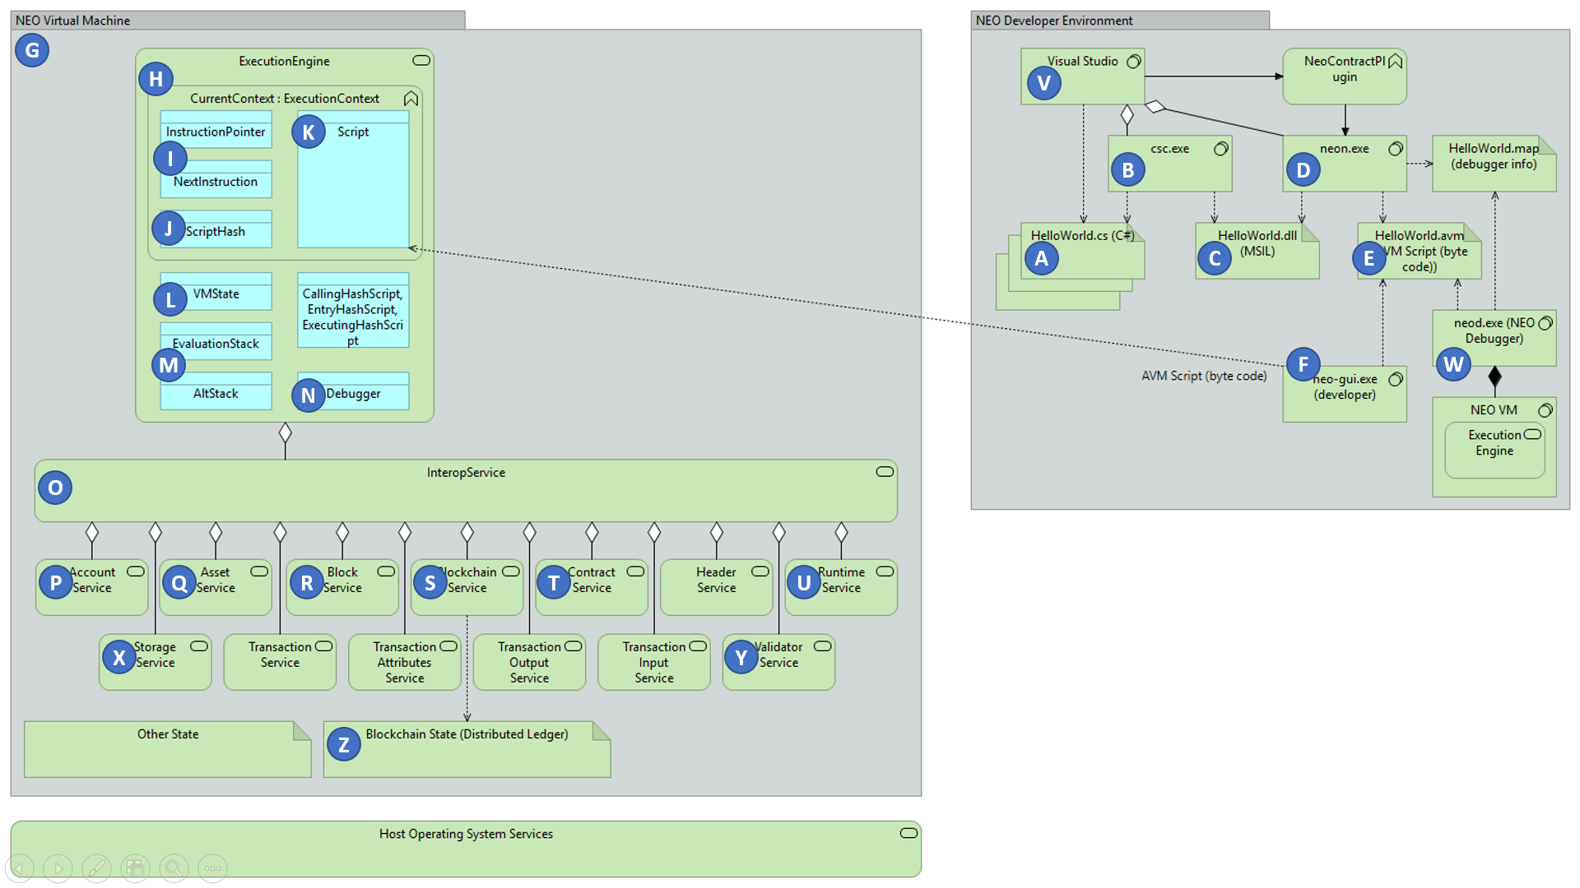
NEO Reference Architecture (neo-charm)
NEO VM
NEO Developer Tools

Slide 53
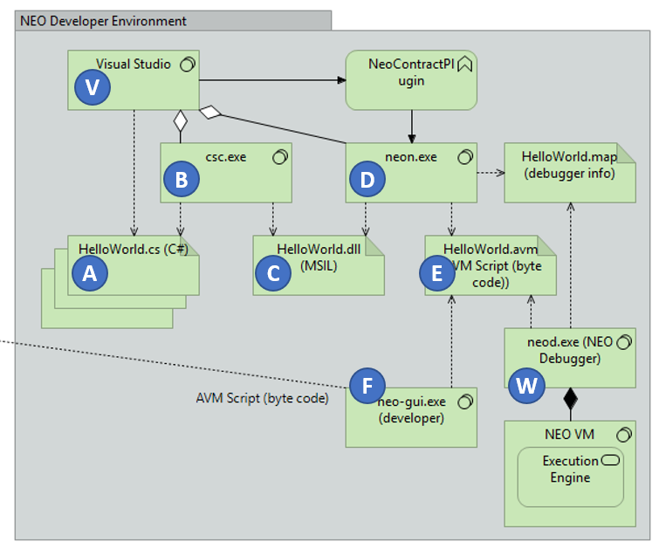
NEO Reference Architecture: Developer
C# Source Code (.cs)
csc.exe
Microsoft Intermediate Language (.dll)
neon.exe
NEO VM Byte Code (.avm)
neod.exe
NEO VM

Slide 54
NEO System Fees http://docs.neo.org/en-us/sc/systemfees.html
System Calls
Instruction OpCodes
 | NEO [Gas] |  |  | NEO [Gas]
Runtime.CheckWitness | 0.2 |  | OpCode.PUSH16 [or less] | 0.00
Blockchain.GetHeader | 0.1 |  | OpCode.NOP | 0.00
Blockchain.GetBlock | 0.2 |  | OpCode.APPCALL | 0.01
Blockchain.GetTransaction | 0.1 |  | OpCode.TAILCALL | 0.01
Blockchain.GetAccount | 0.1 |  | OpCode.SHA1 | 0.01
Blockchain.GetValidators | 0.2 |  | OpCode.SHA256 | 0.01
Blockchain.GetAsset | 0.1 |  | OpCode.HASH160 | 0.02
Blockchain.GetContract | 0.1 |  | OpCode.HASH256 | 0.02
Transaction.GetReferences | 0.2 |  | OpCode.CHECKSIG | 0.10
Account.SetVotes | 1 |  | OpCode.CHECKMULTISIG [per signature] | 0.10
Validator.Register | 1000 |  | Other OpCodes | 0.001
Asset.Create （system asset） | 5000 |  | Constants
Asset.Renew （system asset） | 5000 |  | Flow Control
Contract.Create | 500 |  | Stack
Contract.Migrate | 500 |  | String
Storage.Get | 0.1 |  | Logical
Storage.Put [per KB] | 1.0 |  | Arithmetic
Storage.Delete | 0.1 |  | Cryptography
Other OpCodes | 0.001 |  | Structure
 |  |  | Exceptions

Slide 55
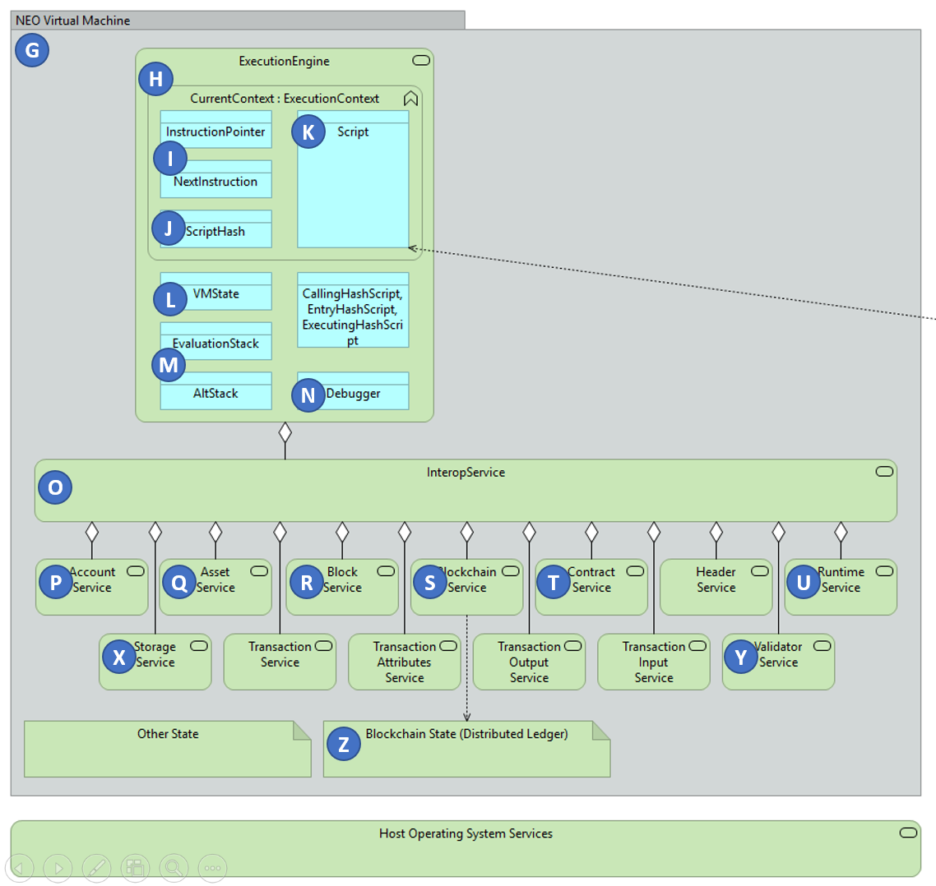
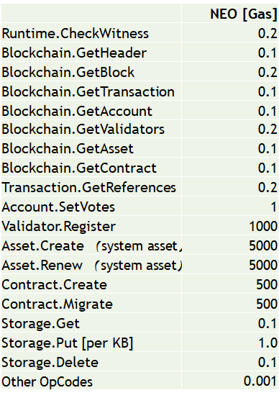
NEO Reference Architecture: NEO Virtual Machine
System Calls

Slide 56
6. Module 2 Labs
NEO Smart Contract Patterns: Process Operation, Domain Name Server, NEP5 Token

Slide 57
Lab 4 – lab4_processoperationpattern.cs
NEO Smart Contract Patterns

Slide 58
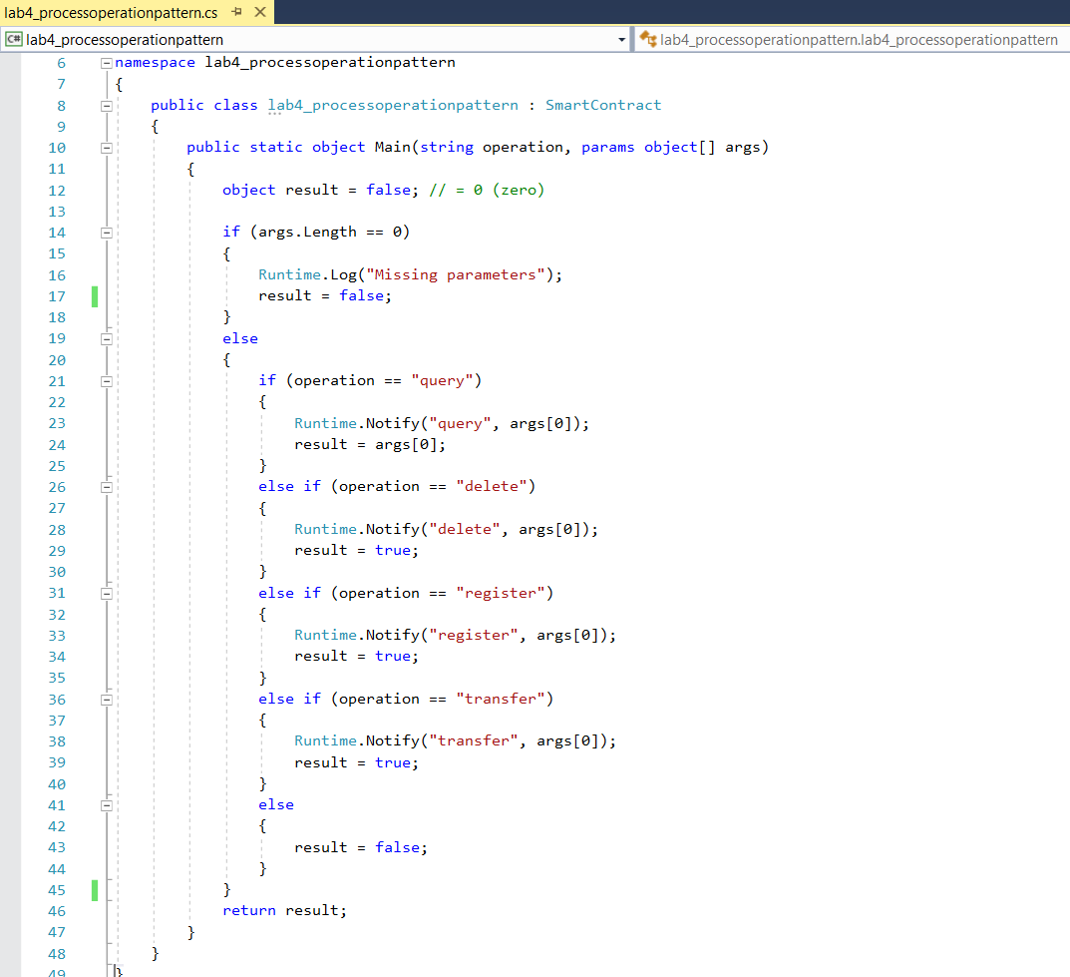

Slide 59
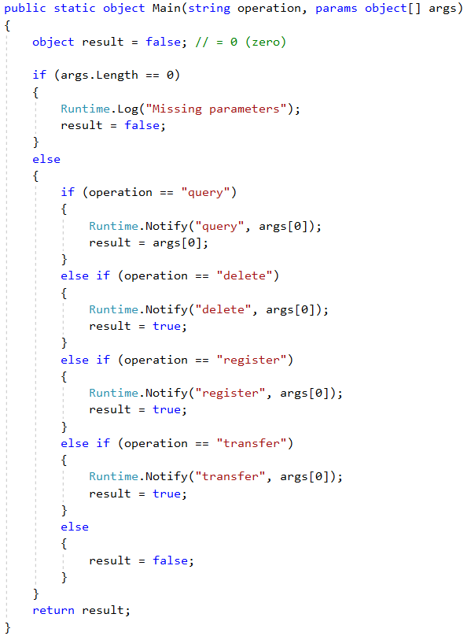
Process Operation Pattern
public static object Main(string operation, params object[] args)
Parameters
operation task to be performed by the smart contract
args parameters need for a specific task
Return Value
object bool, simple value, entity, array of objects

Slide 61
Lab 5 – lab5_domain.cs
NEO Smart Contract Patterns

Slide 62
NEO Account Addresses, Keys and Key Lengths
Description Length (byte[]/HexString) Examples (Bold Lengths)
Address1 (34/68) AcCHoikUq9cP6SMESHufCEMwADJNcTwnAv
Address1 WIF (52/104) L3f7C21q4Mu5FzZsDuCMeHqwJ1apHYCrwzU2821p1opaM43BAMKo
Address1 PublicKeyHex (33/66) 02c44534465c8b21f659eba5708e69edae1ddd6f8cd63004095f8e39493cf54e82
Address1 PrivateKeyHex(32/64) c016e1c8a193cc1a28a15464106b91b52727547a3a36f40a8bfebd9933d1963c
Address1 ScriptHash (20/40) e000aa6a0ab08af8aa78b19d481e5b5c40d8be0e
= Address1.AsScriptHash();
Address2 (34/68) AK2nJJpJr6o664CWJKi1QRXjqeic2zRp8y
Address2 WIF (52/104) KxDgvEKzgSBPPfuVfw67oPQBSjidEiqTHURKSDL1R7yGaGYAeYnr
Address2 PublicKeyHex (33/66) 031a6c6fbbdf02ca351745fa86b9ba5a9452d785ac4f7fc2b7548ca2a46c4fcf4a
Address2 PrivateKeyHex (32/64) 1dd37fba80fec4e6a6f13fd708d8dcb3b29def768017052f6c930fa1c5d90bbb
Address2 ScriptHash (20/40) 23ba2703c53263e8d6e522dc32203339dcd8eee9
= Address2.AsScriptHash();
TxID, AssetID (32/64) 687b68a1159429dc558e4fc7590e391d52f1ef79a12922f941daa37c00334ec5

Slide 63
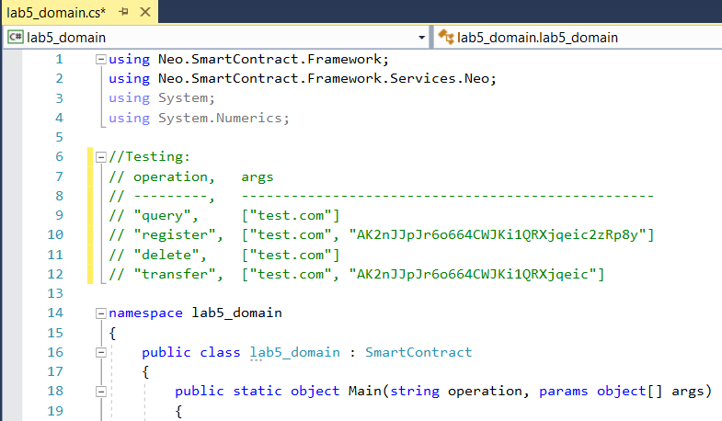

Slide 64
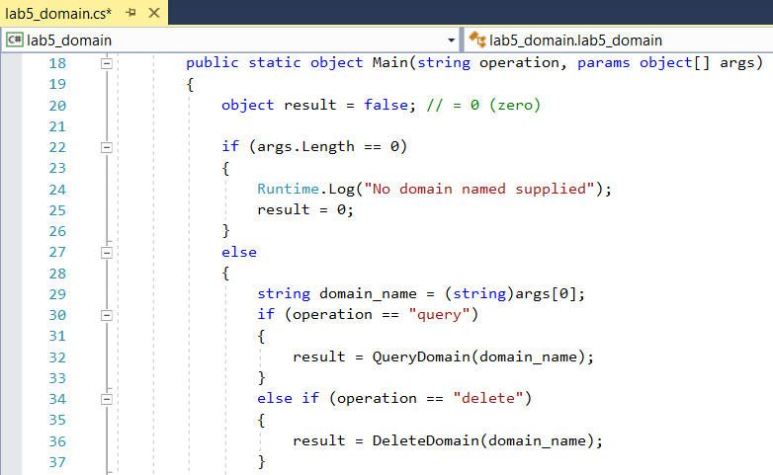

Slide 65
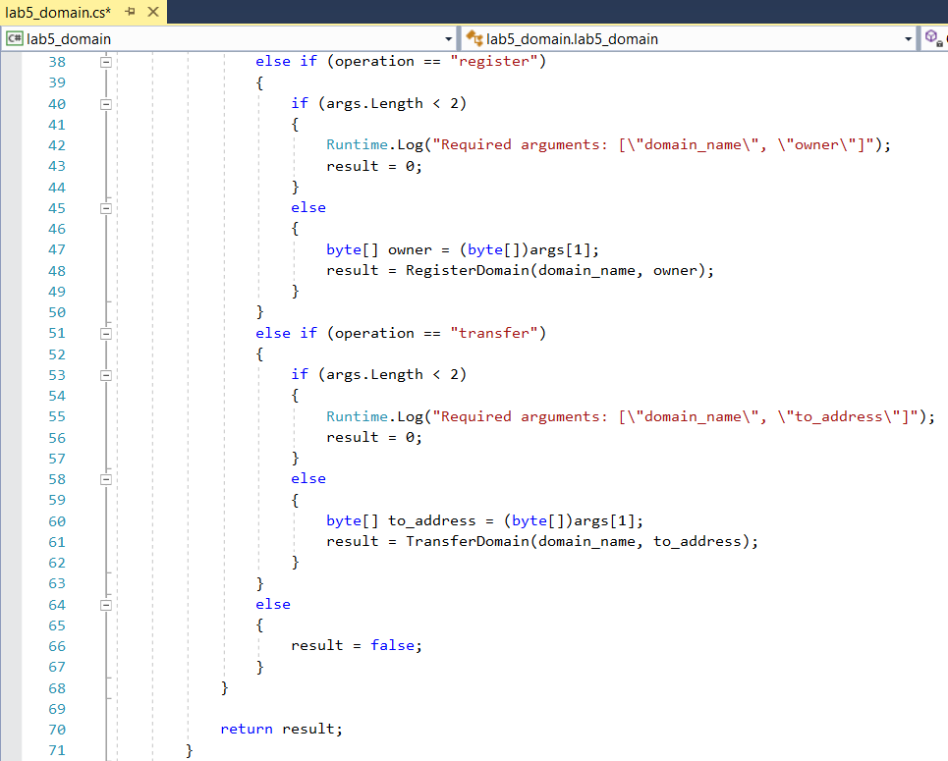

Slide 66
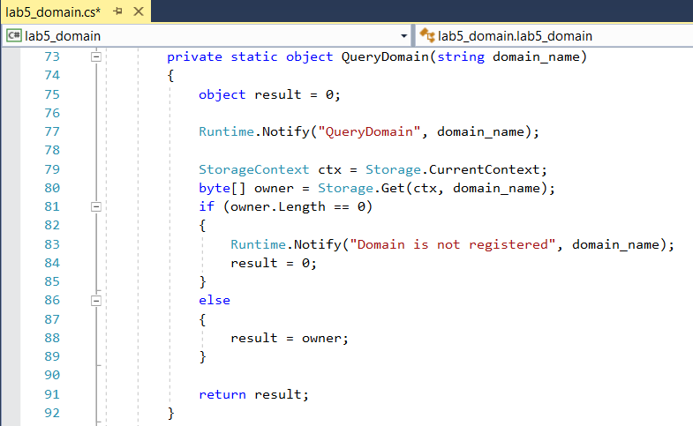

Slide 67
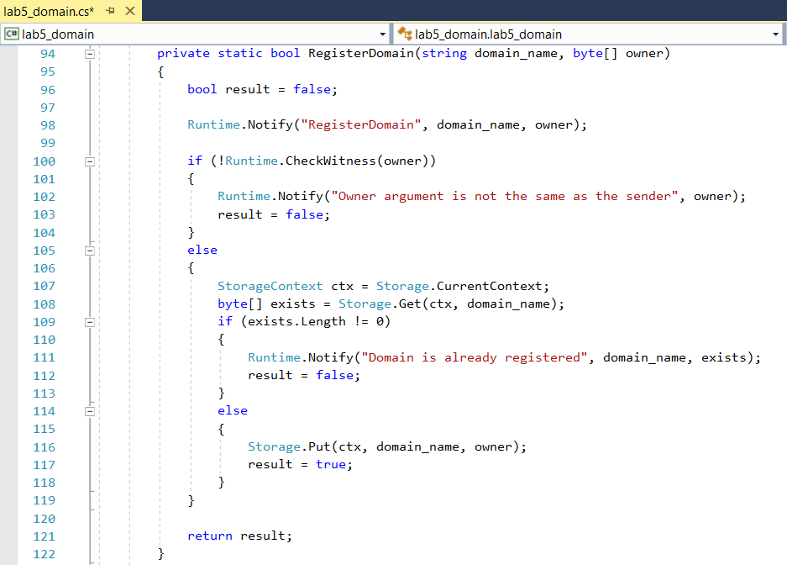

Slide 68
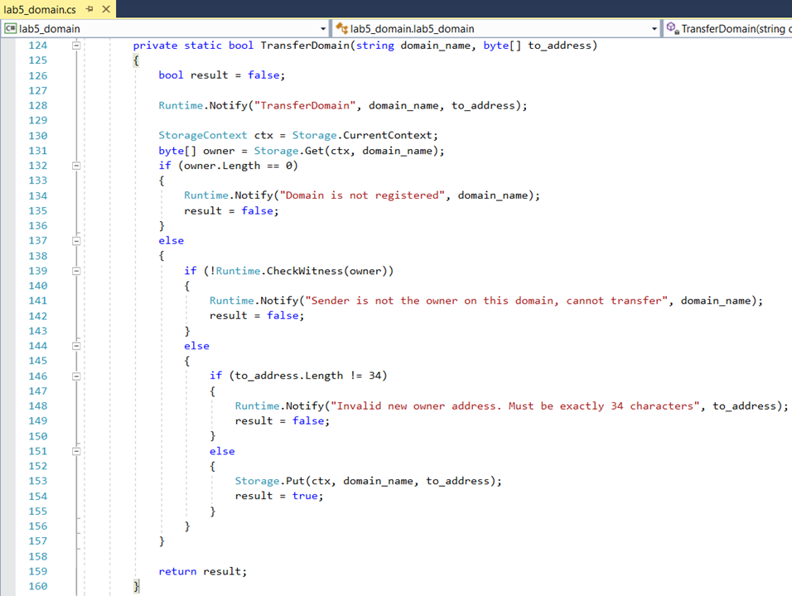

Slide 69
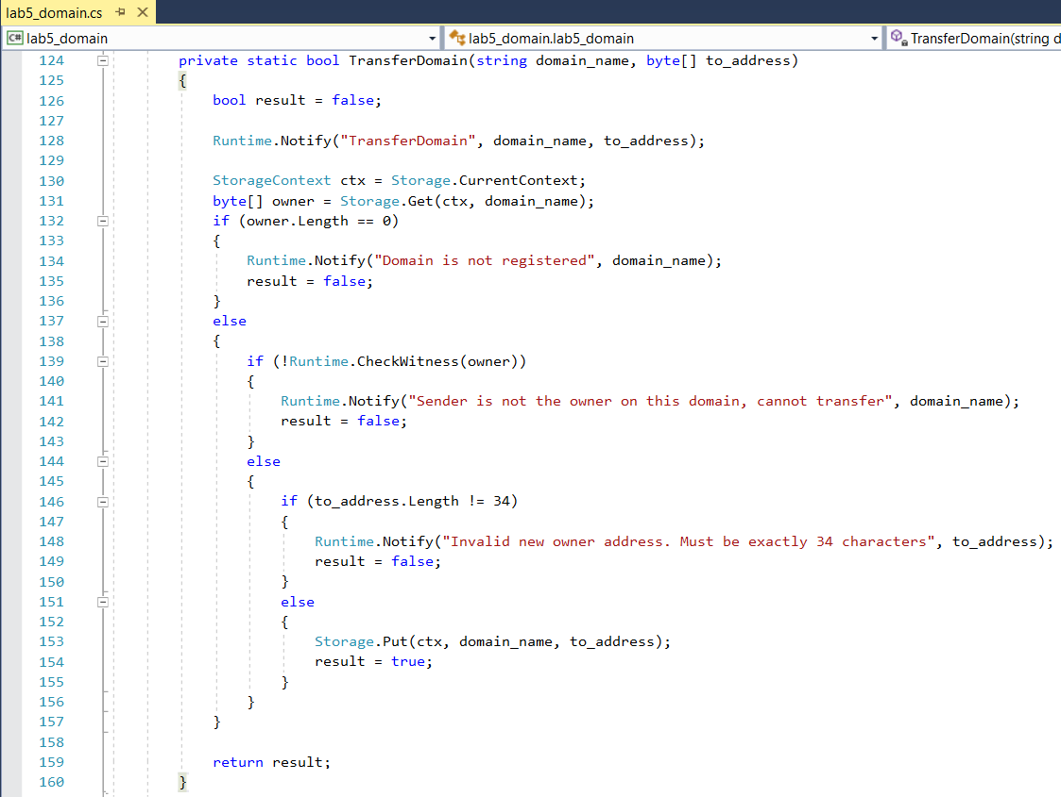

Slide 70
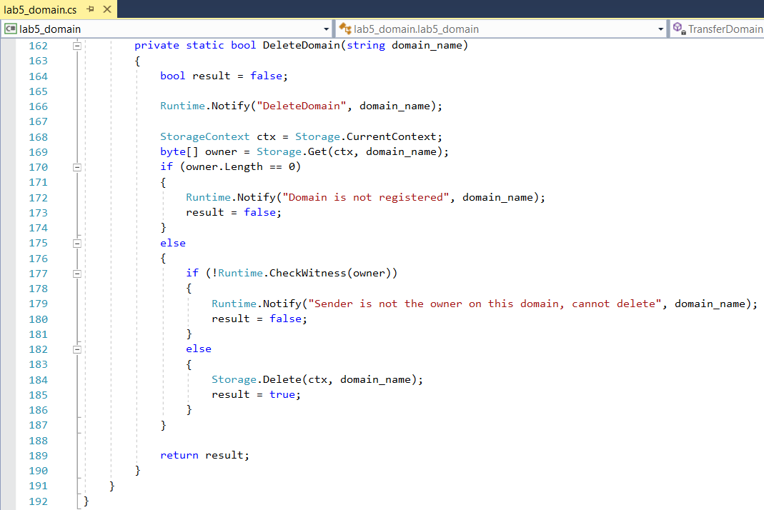

Slide 71
Lab 6 – lab6_NEP5pattern.cs
NEO Smart Contract Patterns

Slide 72
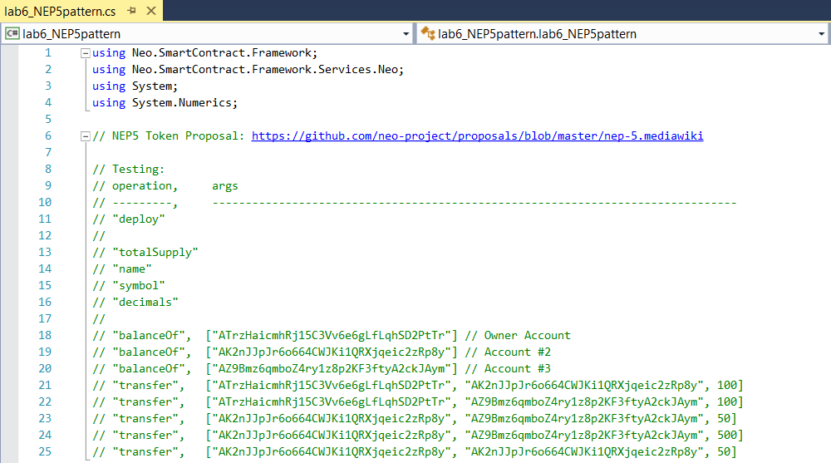

Slide 73
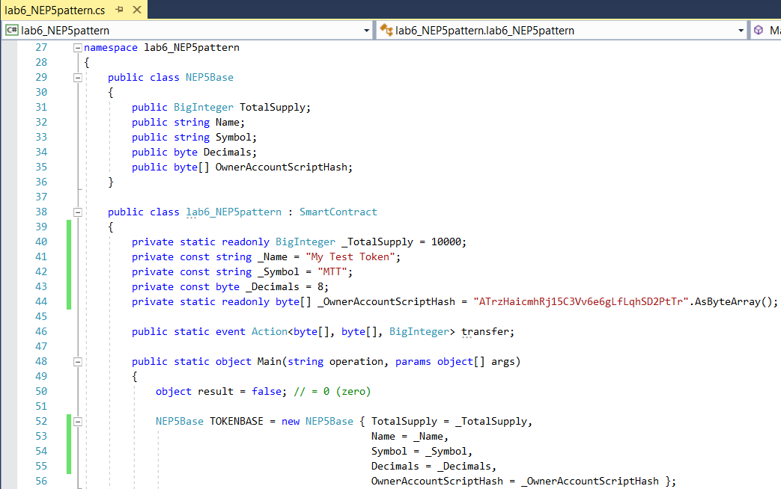

Slide 74
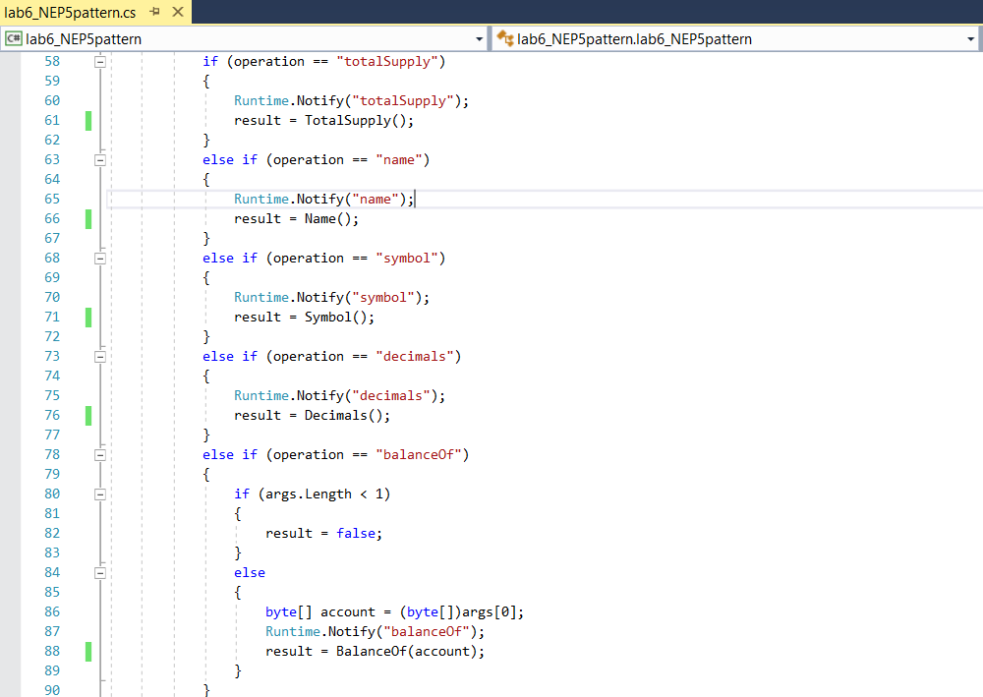

Slide 75


Slide 76


Slide 77


Slide 78


Slide 79
End of Module 2
Lab 4 – lab6_processoperationpattern.cs
Lab 5 – lab5_domain.cs
Lab 6 – lab6_NEP5pattern.cs

Slide 80
7. Why NEO?

Slide 81
NEO was created for Large Scale dApps*
Mainchain speeds
NEO 1000 – 10,000 TPS (single core)
BTC 3 – 4 TPS
ETH 10 – 20 TPS
No transaction fees Initial 10 GAS fee is for free. Simple Smart Contracts can be run for free.
More freedom for application developers to choose the business model that most suits to their business. Service and usage fees can be charged in any way off-chain.
Confirmations needed
NEO 1 and only 1
BTC 6+
ETH 20+
*dApps – Distributed Apps
NEO Persistable Classes make Enterprise App Development real

Slide 82
8. 3rd Generation Distributed App (dApp) Platform

Slide 83

NEO Smart Contracts: “Have it your Way”
Develop, debug and test Smart Contracts in the language you prefer
C# (reference implementation)
Python, Java, Golang, JavaScript
Develop, debug and test Client Apps using the frameworks you prefer
ASP.NET, WinForms, WPF, Console Applications, Window Services, …
Node.JS
Python, Java, Golang, JavaScript

Slide 84
NEO C# Developer Tool Suite (March 2018)
NEO Blockchain Quick Start Guide for .NET Developers (mwherman2000/neo-dotnetquickstart)
NEO Persistable Classes (NPC) Compiler (mwherman/neo-npcc)
NEO NEON Compiler (neo-project/neo-compiler)
NEO Debugger (CityOfZion/neo-debugger-tools)
NEO Node/Wallet (Developer Edition) (CityOfZion/neo-gui-developer)
NEO PrivateNet Docker Container (metachris/neo-privnet-with-gas)
NEO TestNet Network (http://docs.neo.org/en-us/node/testnet.html)
NEO MainNet Network

Slide 85

NEO Smart Contracts: “Have it your way”
Java
Python https://github.com/CityOfZion/python-smart-contract-workshop
Next slide

Slide 86
from boa.interop.Neo.Runtime import Log, Notify
from boa.interop.Neo.Storage import Get, Put, GetContext
def Main():
context = GetContext()
# This is the storage key we use in this example
item_key = 'test-storage-key'
# Try to get a value for this key from storage
item_value = Get(context, item_key)
msg = ["Value read from storage:", item_value]
Notify(msg)
if len(item_value) == 0:
Notify("Storage key not yet set. Setting to 1")
item_value = 1
else:
Notify("Storage key already set. Incrementing by 1")
item_value += 1
# Store the new value
Put(context, item_key, item_value)
msg = ["New value written into storage:", item_value]
Notify(msg)
return item_value

Slide 87
Smart Contract Development: NEO or ETH?
Compare/contrast Ethereum and the NEO Blockchain
Ethereum
NEO
ETH Smart contract == single object with a simple set of methods and simple types of data
ETH is good for
Blockchain version 2.0 Alt tokens
Simple, single entity with only a few methods
Beyond that?
Very little future for Ethereum as an Enterprise Application platform
“One trick pony” x 1500
NEO Smart contract == a program capable of supporting business logic involving dozens of different types of entities
Unlimited potential as an Enterprise Application Platform
Will drive acquisition of NEO
Automatic accumulation of GAS
Increased ability to participate in the NEO Smart Economy
The NEO Blockchain is better (superior) for Enterprise Distributed Applications

Slide 88



NEO Persistable Classes (NPC) NEP5 Token Reference Implementation
Archi: The Free ArchiMate Modelling Tool
https://www.archimatetool.com/

Slide 89
9. Smart Contract Development using Entities
NEO is much more than a key-value data store: Smart Data

Slide 90

NeoDraw - NEO Multi-Person Shared Whiteboard dApp NEO Blockchain as an Enterprise Application Platform
NeoDraw is advanced proof-of-concept distributed application (dApp) for the NEO Persistable Classes (NPC) Entity-based dApp (e-dApp) Platform running on the NEO Blockchain.
Uses 3 entities
UserCredentials
User name and User Password
UserPoint
Array of (X,Y) coordinates/user
NeoCounter
Tracks number points/user

Slide 91



NeoDraw - NEO Multi-Person Shared Whiteboard dApp NEO Blockchain as an Enterprise Application Platform

Slide 92
NPC Layered Functionality
Level 0 Basic
Basic class definition with no supporting methods
Level 1 Managed
Level 2 Persistable
New()
New(…)
Null()
IsNull(e)
Set(e, …)
Setfieldname(e, value)
Getfieldname(e)
Log(“label”, e)
Missing()
IsMissing(e)
Put(e, string key)
Put(e, byte[] key)
Get(string key)
Get(byte[] key)

Slide 93














Architecture
NEO Persistable Classes (NPC) Platform 2.1 Architecture

Slide 94
Think Deeply about the NEO Smart Economy “Future world where the boundary between real assets in the physical world and digital assets in the digital world has been removed.”
transfer
ATrzHaicmhRj15C3Vv6e6gLfLqhSD2PtTr
AK2nJJpJr6o664CWJKi1QRXjqeic2zRp8y
AZ9Bmz6qmboZ4ry1z8p2KF3ftyA2ckJAy
AZ9Bmz6qmboZ4ry1z8p2KF3ftyA2ckJAy
NEP5 / ERC20
Tokens
ATrzHaicmhRj15C3Vv6e6gLfLqhSD2PtTr
requisitions
AK2nJJpJr6o664CWJKi1QRXjqeic2zRp8y
transfer
transfer
payments
requisitions

Slide 95


Slide 96


Slide 97
10. NEO Evidence

Slide 98




NEO Events
Second Wednesday evening of each month
HackCU Episode IV · University of Colorado Boulder
600 Hackers · 24 Hours · February 24th and 25th 2018

Slide 99




NEO Events (con’t)
Second Thursday evening of each month

Slide 100






NEO dApp Competitions ~USD$500K in prizes

Slide 101


Slide 102


Slide 103





NEO News: Switchers
[QTUM to NEO] THEKEY, a Decentralized Ecosystem of Identity Verification Tool Using National Big-data and [NEO] Blockchain https://www.reddit.com/r/NEO/comments/7areac/ama_on_9th_nov_thekey_a_decentralized_ecosystem/
[ETH to NEO] Guardian Circle announce switch to NEO platform https://neonewstoday.com/general/guardium-announce-switch-to-neo-platform/ “...the more we dug into NEO, the more we realized that they had really great answers to every one of our concerns with Ethereum and many additional benefits that are unique to the NEO ecosystem.”
[ETH to NEO] Narrative project: Big News: KYC and Our Switch to NEO https://blog.narrative.network/big-news-kyc-and-our-switch-to-neo-2f34215beef9
[ETH to NEO] Concierge.io NEO Token Sale https://medium.com/@concierge.io/concierge-io-neo-token-sale-f870a0a27b04
[ETH to NEO] IMPORTANT NEWS FOR THE WOWOO COMMUNITY http://wowoonet.com/news.html#news_2018_6
[ETH to NEO] Three things to consider when choosing a blockchain for your project — or why Veris chose NEO. https://medium.com/verisfoundation/three-things-to-consider-when-choosing-a-blockchain-for-your-project-or-why-veris-chose-neo-b4483135c382
[Blockchain agnostic strategy] Jibrel Network founder looking to switch from Ethereum to NEO https://imgur.com/oHYTYi2

Slide 104
11. Resources

Slide 105

NEO Resources: Videos and Webcasts
The New Vision - Da Hongfei https://www.youtube.com/watch?v=th7jZlmoZBc
Malcolm Lerider: Clarification on NEO, GAS and Consensus Nodes https://www.youtube.com/watch?v=iV4WREWtCiI
A Deep Dive into NeoVM & NeoContract [English Subtitles] https://www.youtube.com/watch?v=fLppte-guYE
NEO Persistable Classes (NPC) e-dApp Smart Contract Platform 2.0: Deep Dive https://www.youtube.com/watch?v=Nj4-m2o94VE
NEO – Reddit https://www.reddit.com/r/NEO/

Slide 106
NEO Resources: NEO DevCon 1, January 2018
The New Vision - Da Hongfei | NEO DevCon 1 https://www.youtube.com/watch?v=th7jZlmoZBc
Opening Address - Scott Hunter, Microsoft | NEO DevCon 1 https://www.youtube.com/watch?v=ZFsu5HPU2xM
Ontology, The Technical Vision of Distributed Trust Networks | NEO DevCon 1 https://www.youtube.com/watch?v=QyaZz0vtONs
Imusify, Decentralized Platform for Music Related Digital Content | NEO DevCon 1 https://www.youtube.com/watch?v=dgmfO8nKJkE
NeoAuth, Login Using the NEO Blockchain | NEO DevCon 1 https://www.youtube.com/watch?v=F7teukbcbIg
Phantasma, User-Owned Content | NEO DevCon 1 https://www.youtube.com/watch?v=cinexz6gjsU
NEO•ONE, Development Framework | NEO DevCon 1 https://www.youtube.com/watch?v=yWzjNhiZFmA
THEKEY, A Decentralized Ecosystem of An Identity Verification Tool | NEO DevCon 1 https://www.youtube.com/watch?v=St-UW0lPB7o
NEO’s Global Vision and the Evolving Regulatory Environment - Miles Graham | NEO DevCon 1 https://www.youtube.com/watch?v=FidRGNeab3I
NEX, Decentralized Exchanges | NEO DevCon 1 https://www.youtube.com/watch?v=1005ed20e0Q

Slide 107


NEO Resources
General
NEO.org http://neo.org
NEO Tutorials (C#, Java, Python), API docs http://docs.neo.org
NEO DevCon “Th New Vision” Keynote by NEO Founder https://www.youtube.com/watch?time_continue=3&v=th7jZlmoZBc
Developers
N NEO C# Developers Center of Excellence (neo-csharpcoe) https://github.com/mwherman2000/neo-csharpcoe/blob/master/README.md
Discord NEO Community (like Slack) https://discord.gg/gqCYeup
The NEO Project https://github.com/neo-project
City of Zion awesome-neo project: Developer Docs https://github.com/CityOfZion/awesome-neo/ #developer-documentation

Slide 108
NEO Blockchain C# Developers Center of Excellence https://github.com/mwherman2000/neo-csharpcoe
Founder: Michael Herman (neotoronto@outlook.com)
NEO Blockchain end-to-end, detailed guidance for .NET developers
Content purposely designed to help .NET developers ramp up and become productive more quickly
Repository for content presented at the NEO C# NET Developers Center of Excellence meetup group
Contents
NEO Blockchain Quick Start Guide for .NET Developers https://github.com/mwherman2000/neo-dotnetquickstart
NEO Blockchain Architecture Reference Model (ARM) for .NET Developers (neo-charm) https://github.com/mwherman2000/neo-charm
NEO C# NET Developers Center of Excellence https://github.com/mwherman2000/neo-windocs/tree/master/events/2018-neo-blockchain-toronto

Slide 109
NEO Blockchain Quick Start Guide for .NET Developers https://github.com/mwherman2000/neo-dotnetquickstart/blob/master/README.md
Pre-requisites and Recommendations
Download and install Visual Studio 2017 Community Edition integrated development environment (IDE)
Download and unpack NEO developer tool projects (source)
Coffee time: Wait for previous activities to complete
Install NeoContractPlugin Visual Studio extension
Build and test NEO developer tool projects (from source)
Download, install, and test Docker platform
Download and test NEO privatenet Docker container
Create and compile HelloWorld smart contract sample
Deploy and test the HelloWorld smart contract
Celebrate
Appendix A - Checklist
Appendix B - Roadmap
Appendix C - Reset NEO privatenet Environment: Container, Wallets, and Clients
Statistics
10 activities comprising 130 documented tasks (approximately)
140 screen shots (approximately)
7 batch files
2 JSON configuration files
1 C# code snippet

Slide 110
NEO Blockchain Architecture Reference Model (ARM) for .NET Developers (neo-charm) https://github.com/mwherman2000/neo-charm/blob/master/README.md

Slide 111


Slide 112
12. Next Steps

Slide 113
Call to Action – Your Homework
Build something interesting on the NEO Blockchain
Join Discord https://discord.gg/gqCYeup / https://discord.gg/4TQujHj
Use NEO C# Developers Center of Excellence (neo-csharpcoe) https://github.com/mwherman2000/neo-csharpcoe/blob/master/README.md
Start with NEO Blockchain Quick Start Guide for .NET Developers https://github.com/mwherman2000/neo-dotnetquickstart/blob/master/README.md
Review Workshop for programming smart contracts with .NET, C# and Visual Studio (csharp-smart-contract-workshop) https://github.com/mwherman2000/csharp-smart-contract-workshop/blob/master/README.md

Slide 114


Slide 115
Reminder: When to use Blockchain Technology “Blockchain: the force multiplier for the smart economy” [Microsoft]
Questions to Ask
Use a Blockchain when there is a Need for
Is it a business process that crosses trust boundaries?
Do multiple parties manipulate the same data?
Are processes operating inefficiently or decisions delayed due to the number of intermediaries?
Does the business process involve low-value, manual verification steps?
Real-time transparency by connecting business processes across organizations
Real-time, transparent access to a verifiable source of the truth across organization boundaries
Introduce trust and increase efficiency amongst participants - reducing the need for intermediaries
Improved efficiencies and increased confidence through automation and smart contracts that execute consistently.
“Use blockchain technology when it matches the requirements of your application. Don’t automatically use blockchain technology simply because you’re re-platforming an existing application.” [Gartner 2018]

Slide 116
Why is the NEO Blockchain important?
“The NEO Blockchain will as important or more important than Windows for enterprise distributed application development.” [Michael Herman, March 2018]

Slide 117


“Zero to One” by Peter Thiel, Founder of PayPal

Slide 118

Zero to One: Microsoft Windows

Slide 119



Zero to One: Microsoft Windows

Slide 120

Zero to One: NEO Blockchain Platform

Slide 121


Slide 122

I leave you with a challenge… Become part of the NEO Smart Economy
hyperonomy.com – digital intelligence (my blog)
https://hyperonomy.com/2018/01/24/tokenization-of-every-little-thing-elt/

Slide 123
Questions?
Michael Herman (Toronto) – Independent Blockchain Architect and Developer
E: mailto:neotoronto@outlook.com M: https://www.meetup.com/NEO-Blockchain-Toronto G: https://github.com/mwherman2000/neo-csharpcoe/tree/master/events F: https://www.facebook.com/neotoronto/ T: https://www.twitter.com/neotoronto

Slide 124
Backup Slides

Slide 125

NEO Persistable Classes (NPC) YouTube Channel https://www.youtube.com/playlist?list=PLU-rWqHm5p46bIDXPNf4c2JP_AOkopnV5

Slide 126
Our Values as Neoxplorers
We operate like the NEO Blockchain
Decentralized
Community based
Consensus driven
Creators of value
Store of value (knowledge)
Transfer of value (training)
Multi-disciplinary
Multi-application
Multi-technology
We behave like the NEO Blockchain
Robust
Reliable
Transparent
Smart
Open
Non-discriminatory
Participatory
Diversity
Committed

Slide 127

What’s the next category of Blockchain Killer Apps?

Slide 128


